Slide 1
MONITOR
LED LCD OLED QLED WLED
SUBMITTED TO
SUMITTED BY
Md Mahbub E Noor
Assistant Professor
Dept. of Computer Science & Engineering
University of Barishal
Lamia Khanom
Merit Position: 4966

Slide 2
INTRODUCTION
Modern monitors come in a variety of display technologies, each with distinct features and advantages. Understanding the differences between LED, LCD, OLED, QLED, and WLED monitors is essential when choosing the right display for your needs. In this presentation, we will explore each of these technologies, their pros and cons, and how they impact the performance and visual quality of monitors.
LED (Light Emitting Diode)
Overview:
LED monitors are actually a type of LCD display. The term LED refers to the backlighting technology used in these monitors. Unlike traditional CCFL backlighting, LED backlights use LEDs to illuminate the liquid crystals.
Key Features:
LED Backlighting: Uses LEDs to provide the light source behind the LCD panel.
Edge-lit vs Full-array: LED monitors can either be edge-lit (LEDs around the edges) or full-array (LEDs across the entire panel).

Slide 3
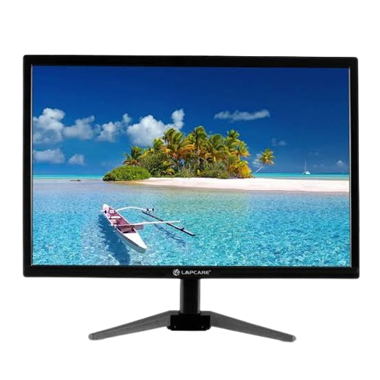
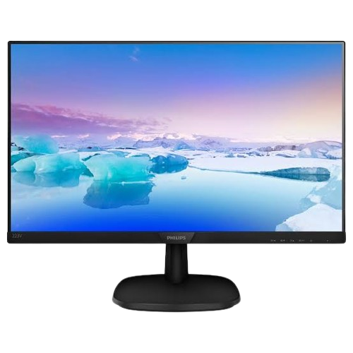
Pros:
•Thinner and more energy-efficient than CCFL-backlit LCDs.
•Can achieve better brightness and contrast ratios than traditional LCDs.
•Available in both edge-lit and full-array configurations.
Cons:
•Still relies on liquid crystals, so black levels may not be as deep as OLED.
•Edge-lit models may have uneven lighting.
LCD (Liquid Crystal Display)
LED Monitor
Key Features:
•Backlight: Typically uses cold cathode fluorescent lamps (CCFL) or LED as backlight.
•Resolution & Colors: Offers good color accuracy but can struggle with deep blacks and contrast ratios.
•Energy Efficient: More energy-efficient than CRTs, but less efficient than newer technologies like OLED.
Overview:
•LCD is a type of display technology that uses liquid crystals to create an image. These liquid crystals don't emit light by themselves but instead modulate light from a backlight.
LCD Monitor

Slide 4
Cons:
•Limited contrast ratios.
•Less vibrant colors compared to OLED.
•Poor black levels (blacks appear gray due to backlight bleed).
Pros:
•Inexpensive to manufacture.
•Wide range of sizes and resolutions.
•Low power consumption compared to older CRT monitors.
OLED (Organic Light Emitting Diode)
Overview:
OLED is a display technology where each individual pixel emits its own light, unlike LCDs, which require a backlight. This allows for true blacks and exceptional contrast.
Key Features:
•Self-Emitting Pixels: Each pixel can turn on or off independently, offering true black levels and infinite contrast.
•Vibrant Colors: OLED displays can reproduce a wide color gamut and more vibrant colors compared to traditional LED/LCD displays.

Slide 5
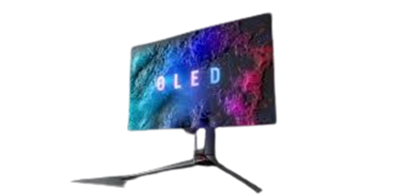
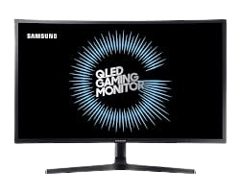
Pros:
•Excellent contrast ratios and true blacks.
•Faster response times, making them ideal for gaming.
•Wider viewing angles without color distortion.
Cons:
•Can be more expensive than LED/LCD monitors.
•Prone to burn-in (permanent image retention) if static images are displayed for long periods.
•Shorter lifespan compared to LED displays, especially in blue OLEDs.
OLED Monitor
QLED (Quantum Dot LED)
Overview:
QLED is a term coined by Samsung, referring to Quantum Dot LED technology. It's a variation of LED/LCD technology that uses a layer of quantum dots between the LED backlight and the LCD panel.
Key Features:
•Quantum Dots: These nanometer-sized particles improve brightness, color accuracy, and overall image quality.Full •Array Local Dimming (FALD): Many QLED displays feature this technology, allowing for enhanced contrast by dimming or brightening specific areas of the screen.
QLED Monitor

Slide 6
Pros:
•Offers a wider color gamut and better color accuracy than standard LED displays.
•Can reach higher brightness levels than OLED, making them better suited for bright rooms.
•Improved contrast ratios and deeper blacks with local dimming.
Cons:
•Still uses a backlight, so blacks aren’t as deep as OLED.
•Expensive compared to standard LED displays.
WLED (White LED)
Key Features:
Backlighting Technology: WLED uses a white LED light source to illuminate the liquid crystal panel.No Color Filter: Some WLED displays use a phosphor coating on the LEDs to improve color quality.
Overview:
WLED stands for White LED. This is a type of LED backlighting used in LCD displays where the backlight is provided by white LEDs.

Slide 7
Pros:
•More energy-efficient than traditional CCFL backlights.
•Can achieve bright and uniform screen lighting.
Cons:•Not as color-accurate or vibrant as QLED or OLED.
•Limited contrast compared to OLED or QLED.
Each display technology — LCD, LED, OLED, QLED, and WLED — has its own strengths and weaknesses. Your choice depends on factors such as budget, intended use, and personal preferences for color accuracy, brightness, and contrast. Whether you're a gamer, a content creator, or simply looking for a quality monitor for daily use, understanding these technologies will help you make an informed decision.
CONCLUSION
Choosing the Right Monitor for Your Needs
For Budget-Conscious Users: LCD or WLED monitors are affordable and offer decent performance for basic tasks like office work or web browsing.For Gaming or Multimedia Enthusiasts: OLED offers unbeatable contrast, fast response times, and superior color accuracy, making it a top choice for gamers and those who enjoy high-quality video content. Be mindful of burn-in risk.For Bright Rooms and Color Accuracy:QLED excels in bright environments and can deliver better overall brightness and color volume than OLED. It’s perfect for vibrant media consumption or HDR content.For Standard Use and Energy Efficiency:LED or WLED displays are still a solid choice for most everyday tasks, offering good energy efficiency and visual quality at a reasonable price.

